Slide 1
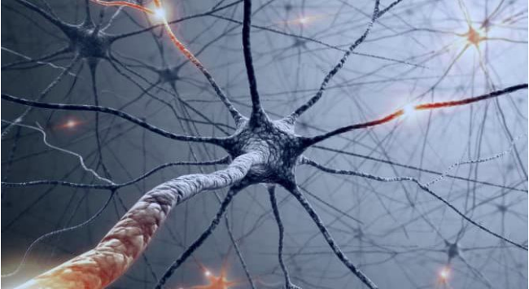
Guidance Cue
Maricris Macabeo
NF Hackathon 2
9/15/19
Notes:
Image Resource: http://versionfinal.com.ve/tecnologia/la-menor-produccion-de-energia-neuronal-hace-al-cerebro-mas-proclive-a-enfermedades/

Slide 2
Project Goal: To explore the role of slit/robo pathway in the neurofibroma samples.
Method:
1. Used pre-developed tools (GSVA) in Bioconductor to discover normalized expression levels of guidance cue markers in all the samples available.
2. Visualized the slit/robo pathways in all the the samples.
3. Correlate significance of slit/robo pathways with the rest of the pathways.

Slide 3
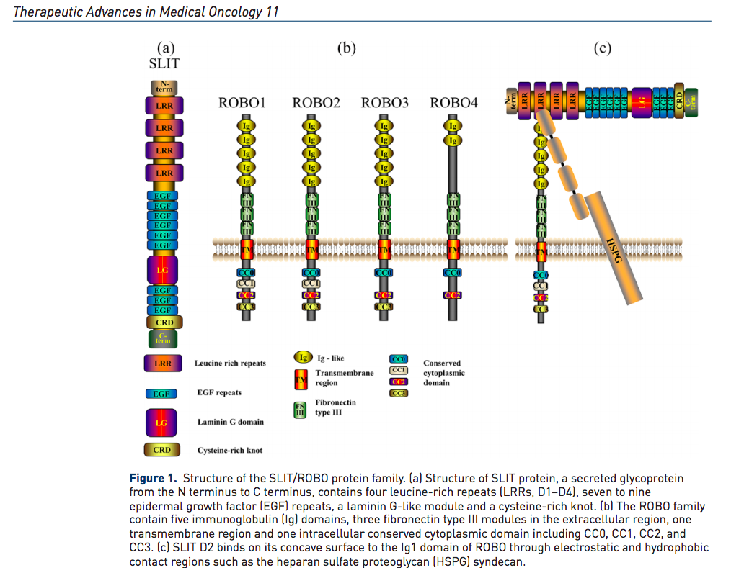
Slit/Robo

Slide 4
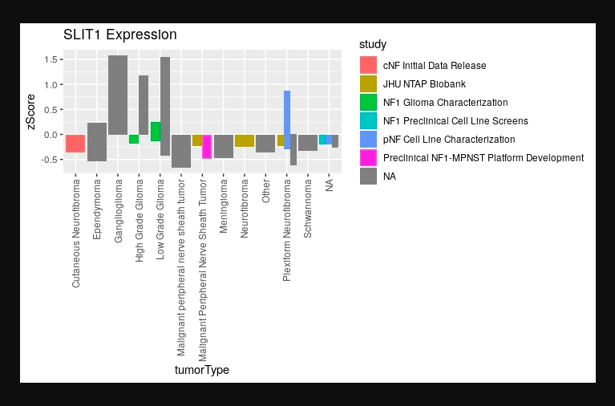
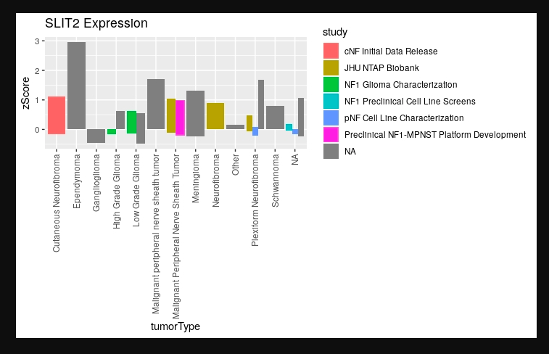
Normalized Expression Level

Slide 5
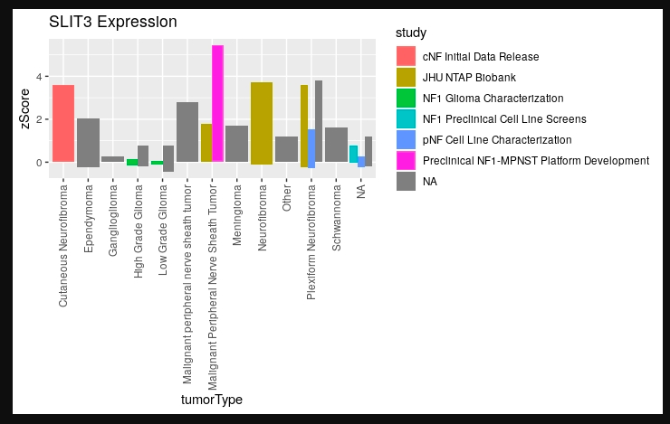
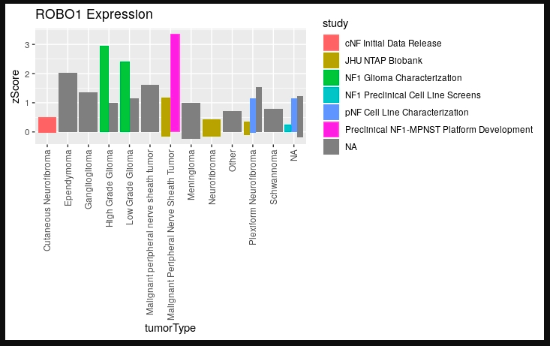
Normalized Expression Level

Slide 6
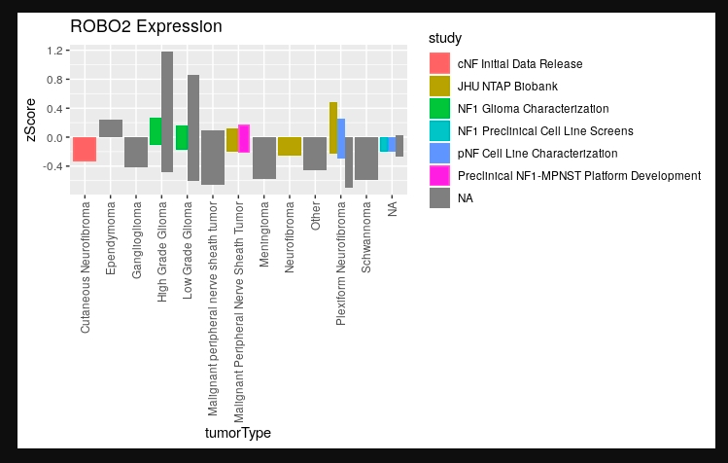
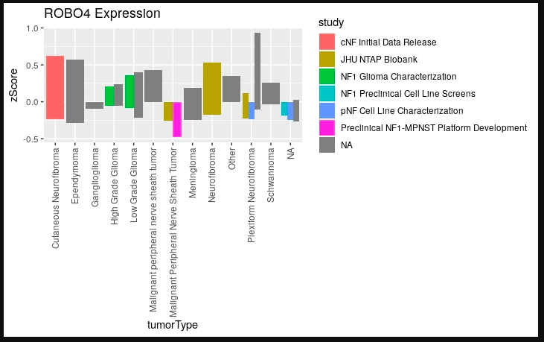
Normalized Expression Level

Slide 7
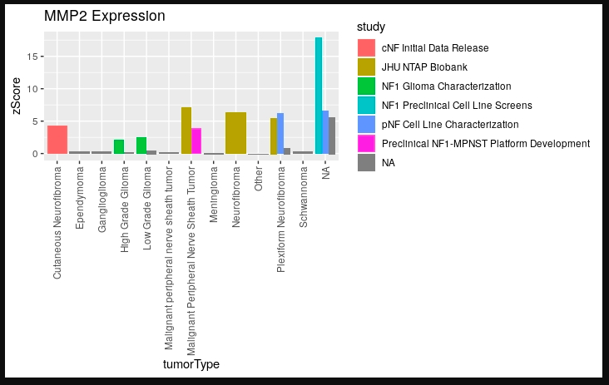
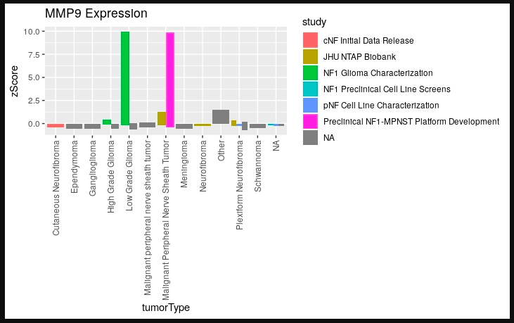
Normalized Expression Level

Slide 8
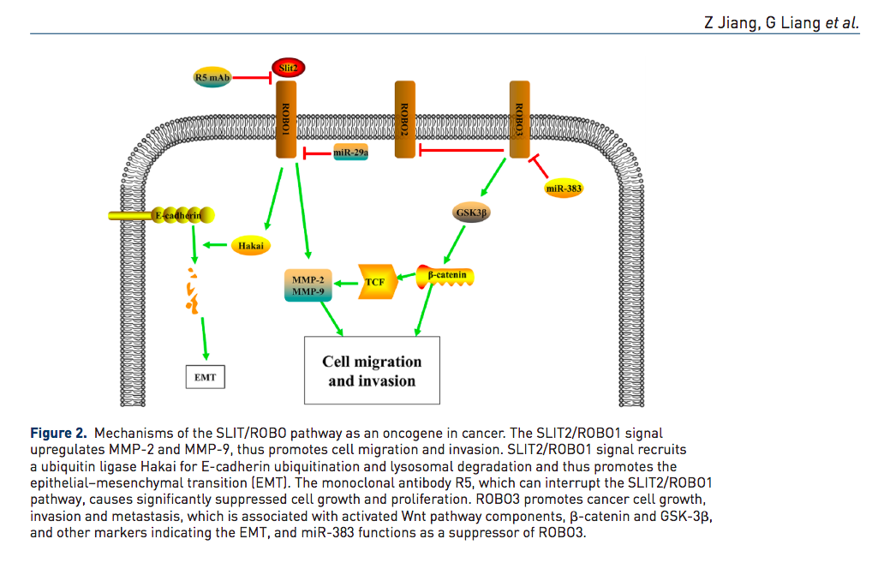
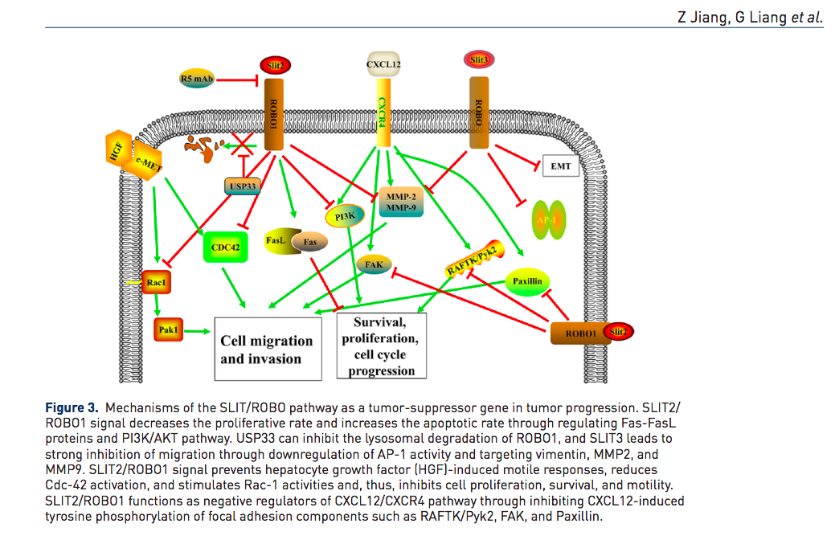
Slit/Robo Pathway

Slide 9
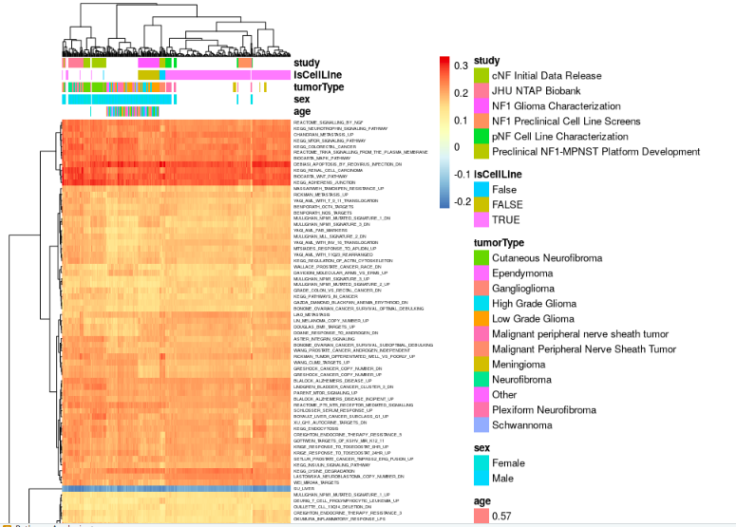

Slide 10
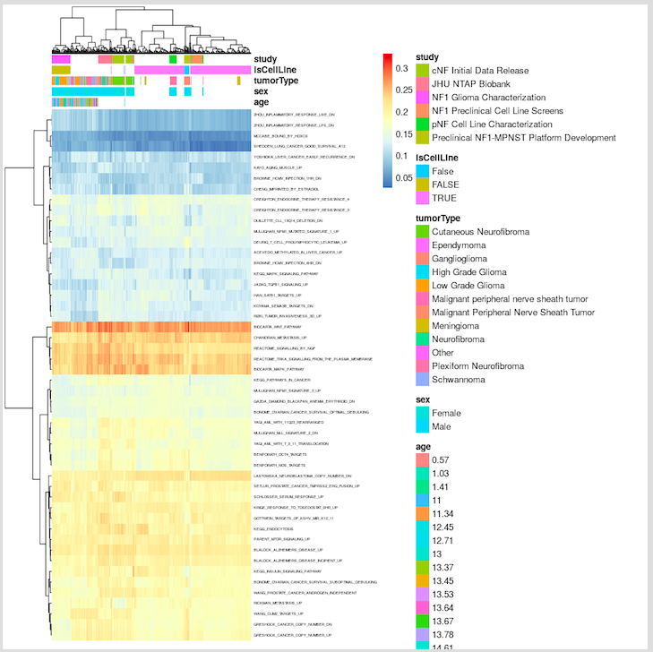

Slide 11
Conclusion
Move over merlin, we may have a new role player in town!
What is the role of slit/robo pathway in the neurofibromas?

Slide 12
Reference
https://journals.sagepub.com/doi/pdf/10.1177/1758835919855238
Oster SF¹, Deiner M, Birgbauer E, Sretavan DW. Ganglion cell axon pathfinding in the retina and optic nerve. Semin Cell Dev Biol. 2004 Feb;15(1):125-36.

